Slide 1
TELEMETRY SYSTEM
Creating a live measuring and communication system
Lucas PRIEELS

Slide 2
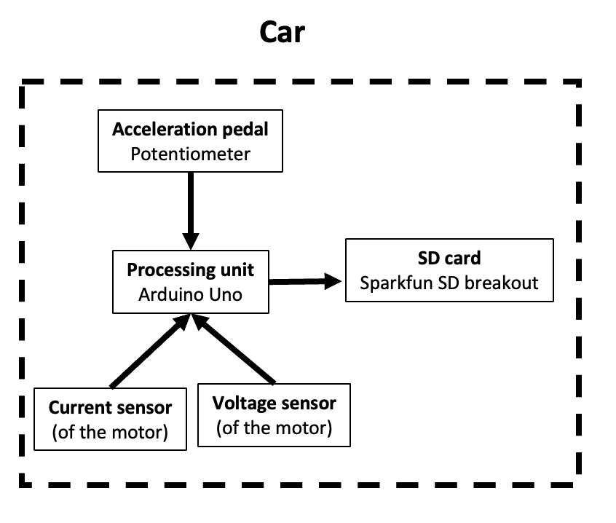
TELEMETRY SYSTEM
Status from last year
Very limited measurements
Motor current
Motor voltage
Potentiometer value
No live communication
Only stored on an SD card

Slide 3
TELEMETRY SYSTEM
Goals
Connect additional sensors
Power and energy used by motor
GPS position of the car
Speed of the car
Create a live communication system
Receive and show data live

Slide 4
TELEMETRY SYSTEM
Choice of sensors
Accelerometer
Measures acceleration and (estimated) speed
Price, precision, refresh rate, 3-axis
GPS sensor
Measures position, speed, and time
Price, power usage, compatible with multiple GNSS, configuration time
Current and voltage sensors
Updated by the powertrain team with the buck converter
SD card
Same as last year

Slide 5
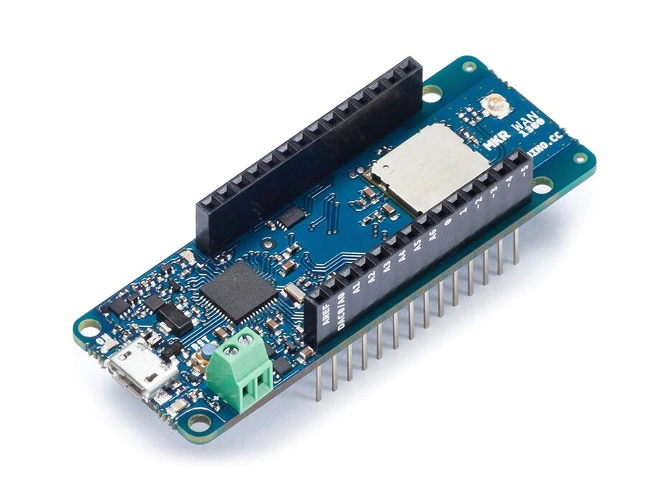
TELEMETRY SYSTEM
Wireless communication
Cellular communication (GSM/3G, or NB-IoT/LTE-M)
Needs connection to a base station
Unlimited range
GSM, 3G : Large power consumption
SD card and cellular subscription
Very large data rate
Radio communication
2 components required
Range might be a bit short
Legal restrictions on power emission
Radio communication chosen for power usage and coverage reasons
Arduino MKR WAN 1300/1310 : LoRa, acts as a uc, quite immune to interference, power consumption settable

Slide 6
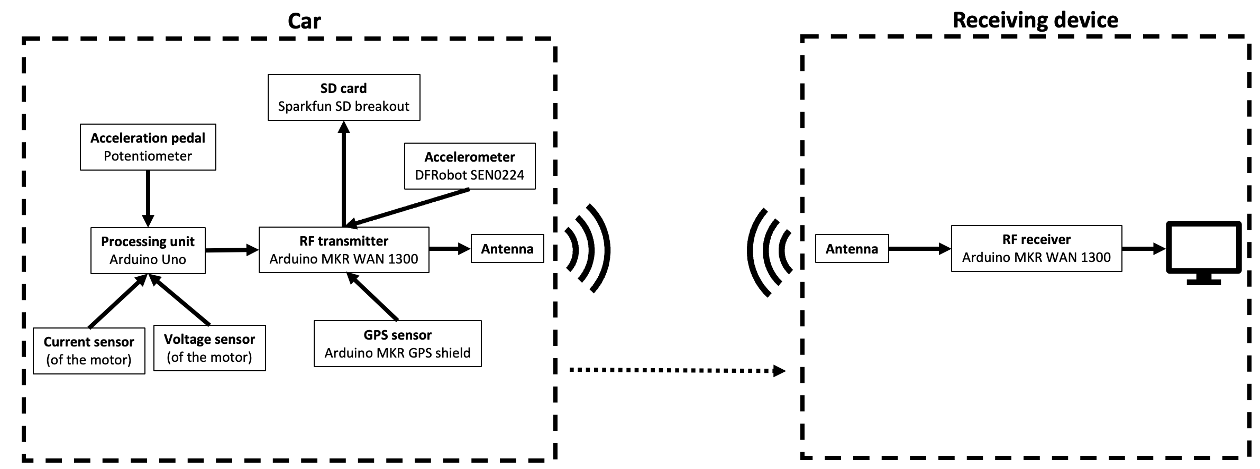
TELEMETRY SYSTEM
Overview

Slide 7
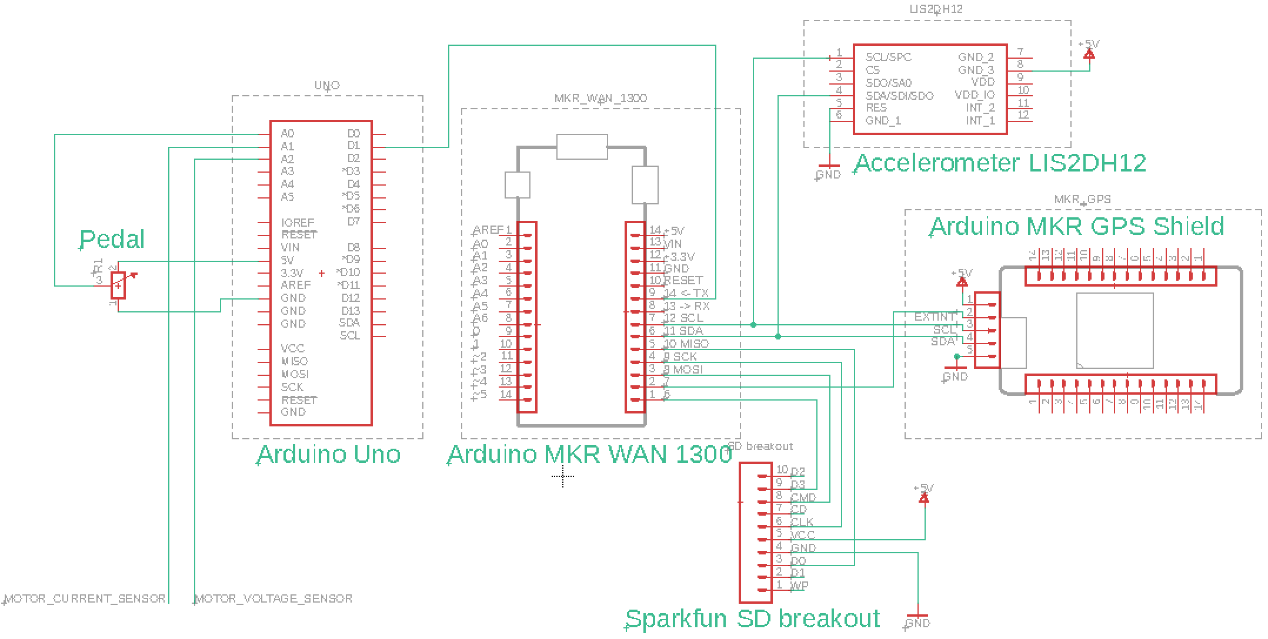
TELEMETRY SYSTEM
Implementation
Electrical connections
Programming of the boards
UART, SPI and I2C connections
Derived calculations
Electrical power and energy usage
Smooth speed
Average speed
Distance traveled

Slide 8
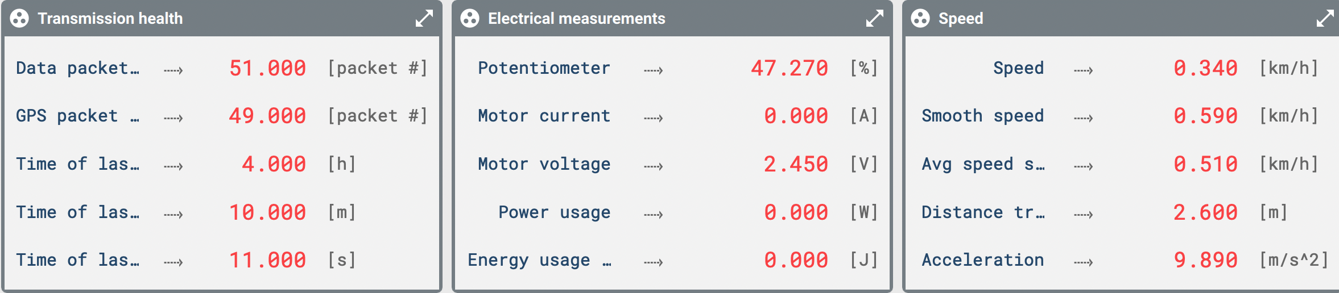
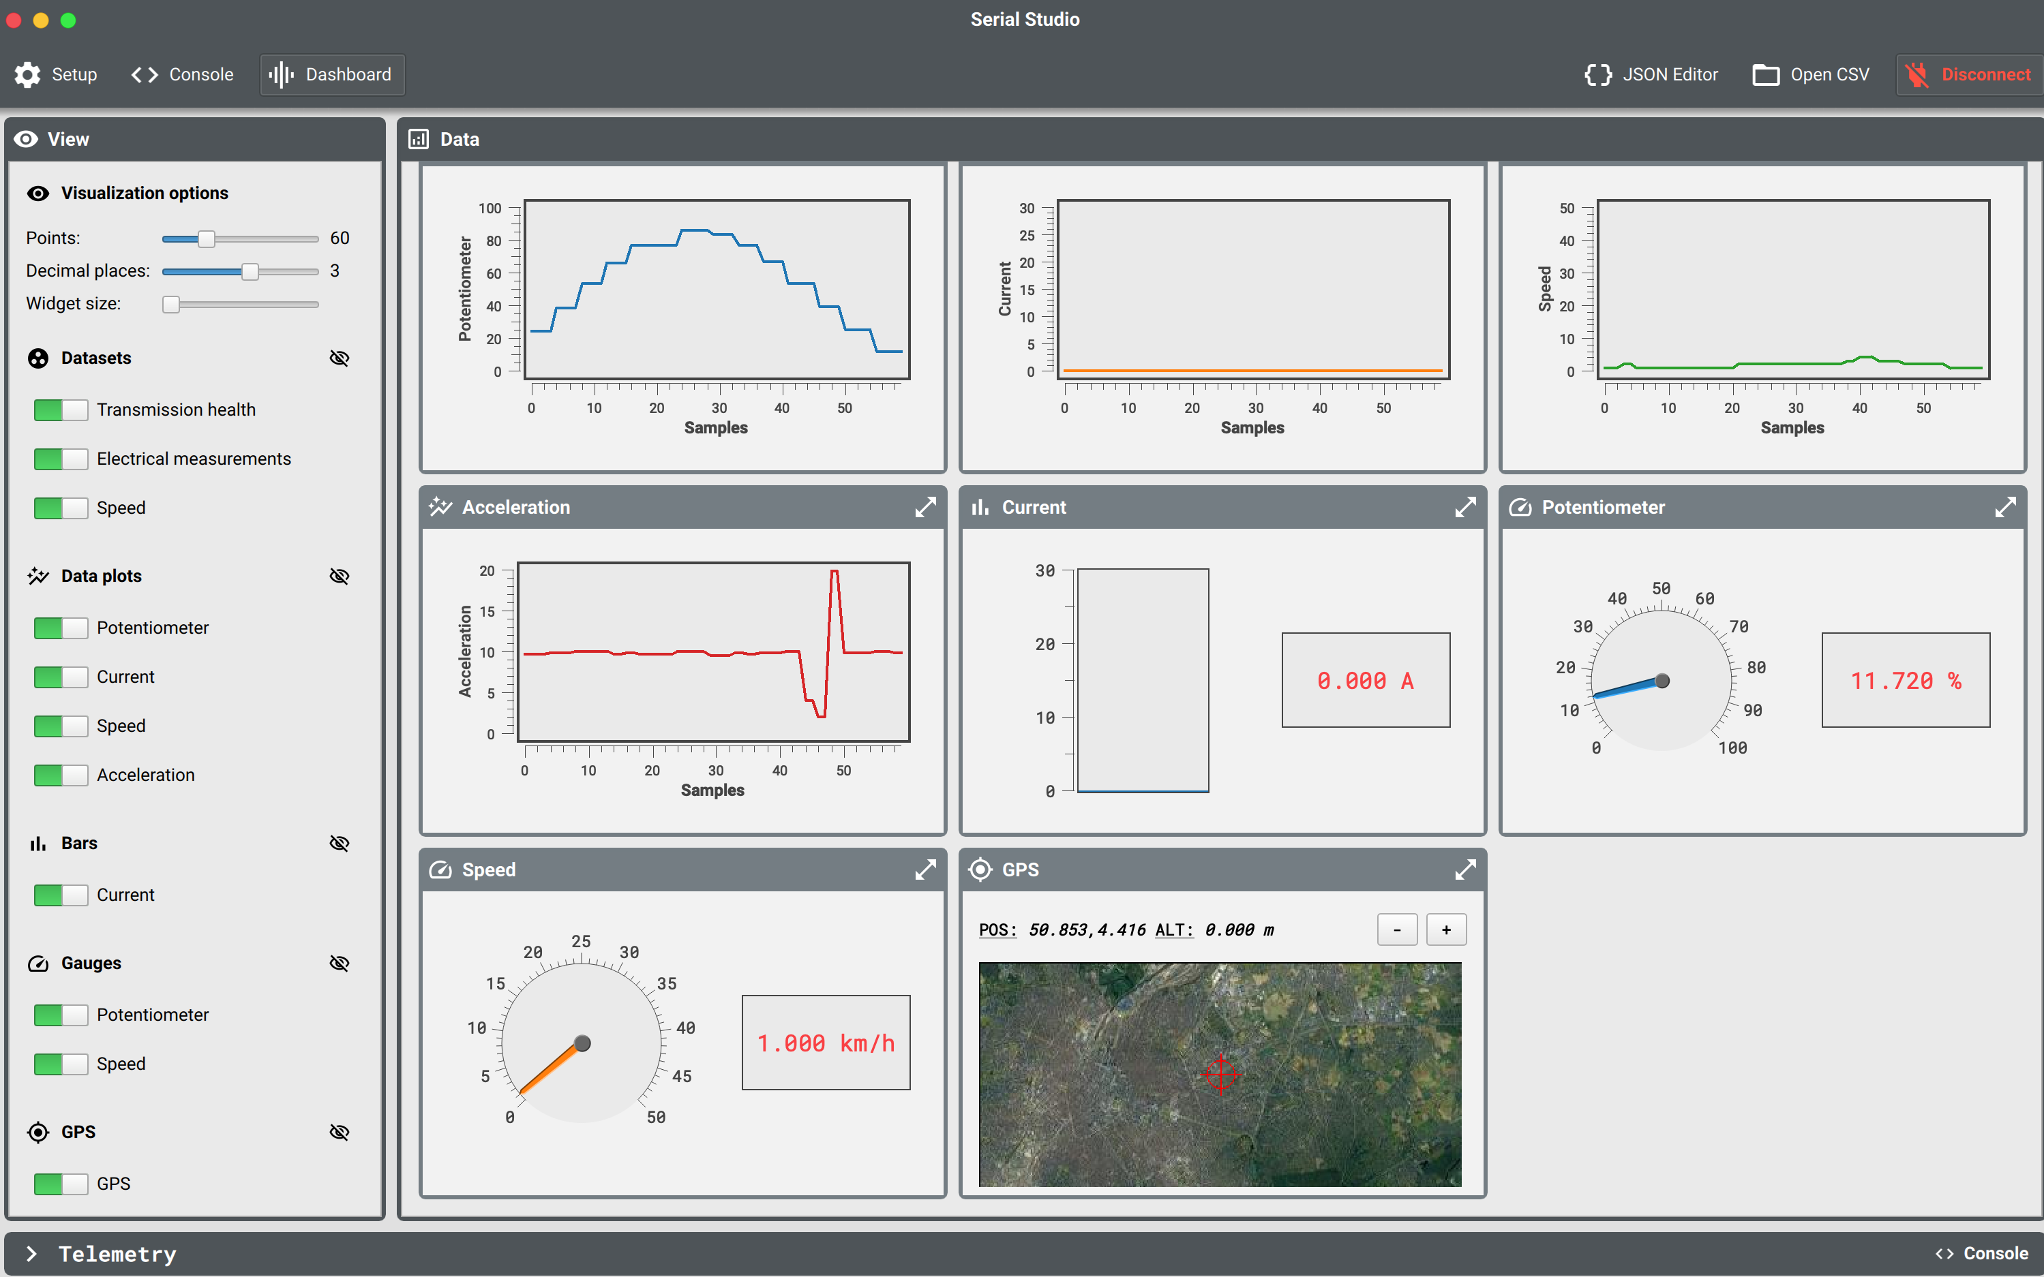
TELEMETRY SYSTEM
Real-time data processing

Slide 9
TELEMETRY SYSTEM
Conclusion
Functionalities
Measurements performed : position, speed, current voltage, pedal pressing
Derived values : energy, power, distance traveled, average speed
All measurements stored on an SD card
Sent wirelessly
Data analyzed and plotted in real-time
Possible improvements
In-depth analysis of data to define a driving strategy
Send data to the driver

